Slide 1
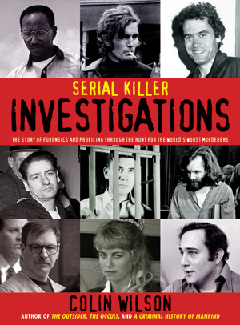
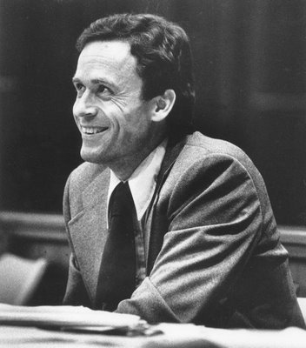
Serial Killers
Forensic Psychology
Notes:
Bundy, Berkowitz,

Slide 2

What is a serial killer?
What characteristics come to mind?

Slide 3
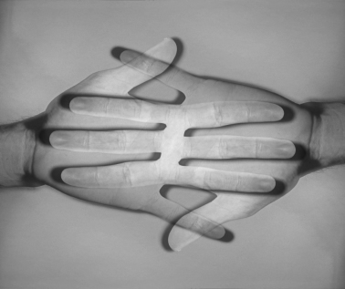
Misconception #1
Serial killers are the same as mass murderers
  Serial killers kill several people over a series of days, weeks, months, or even years.
    Active period and cooling off period
  Mass murderers kill a number of people within a few hours
    Murder in an outburst with no cooling off period
    Ex – Columbine shootings

Slide 4
Misconception #2
Serial killers are complete losers who cannot function normally in society.
  It’s more common for serial killers to live normal lives – this is part of the reason why they are successful in their killings
    Ex: Ted Bundy – considered very charming

Slide 5
Forensic Psychology
Where law meets the study of the mind, you’ll find the Forensic psychiatric/psychological professional.
Psychiatrist is a medical doctor – medical treatment of the psyche
Psychologist is not a medical doctor – study of the mind and behavior
BOTH – mental health professionals – expertise is the mind and the way it affects behavior and well-being
WHY?
The law and medical aspects of crime are often at odds.
→ Insane or not?
→ Competent to stand trial or not?
Notes:
If the court determines that a defendant's mental condition makes him unable to understand the proceedings, or that he is unable to help in his defense, he is found incompetent. The competency evaluation, as determined in Dusky v. United States, is whether the accused "has sufficient present ability to consult with his lawyer with a reasonable degree of rational understanding—and whether he has a rational as well as factual understanding of the proceedings against him." Being determined incompetent is substantially different from undertaking an insanity defense; competence regards the defendant's state of mind at the time of the trial, while insanity regards his state of mind at the time of the crime.
The word incompetent is also used to describe persons who lack mental capacity to make contracts, handle their financial and other personal matters such as consenting to medical treatment, etc. and need a legal guardian to handle their affairs.

Slide 6
Role of the Forensic Psychologist
Assessment of mental state for insanity plea
Competency to stand trial
Sentencing recommendations
Evaluations of the risk of reoffending
Testimony as an expert witness
Child custody evaluations

Slide 7
Types of Murderers
Mass Murderer
Spree Murderer
Serial Killer

Slide 8
Types of Murderers
Mass Murderer – kill 4 or more people in one place at one time.
    Have clear agenda – know why
    No “cooling-off” period
    May want to send a “message.”
    Higher the death toll – better the job done
    Typically ends with death of perpetrator – suicide or killed by law enforcement

Slide 9
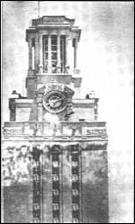
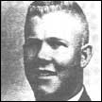
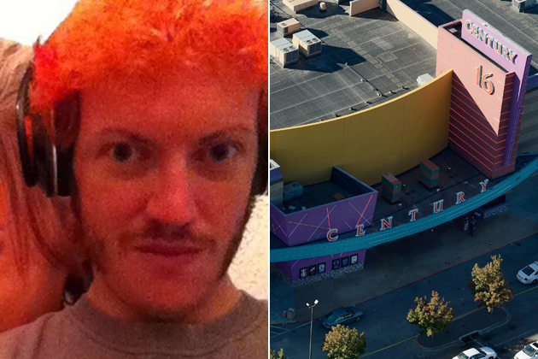
Some Famous Mass Murderers
August 1, 1966 – Charles Whitman
Killed 14 people and injured dozens in shooting from the top of a tower on the campus of the University of Texas.
Entire episode lasted 90 minutes.
July 20, 2012 – James Eagan Holmes
Killed 12 and injured 58 in Aurora, Colorado during a midnight screening of The Dark Knight Rises.
Entire episode lasted 7 minutes.

Slide 10
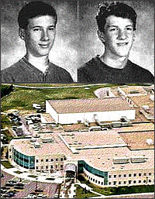
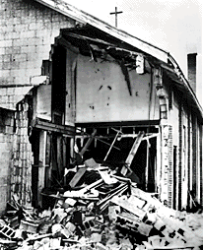
Some Famous Mass Murderers
April 20, 1999
Eric Harris and Dylan Klebold murder 13 and injure 21 in a high school in Columbine, Colorado.
Entire episode lasted an estimated 90 minutes
September 15, 1963
16th Street Baptist Church in Birmingham, Alabama was bombed by 4 KKK members killing 4 children and injuring 22.

Slide 11
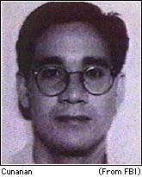
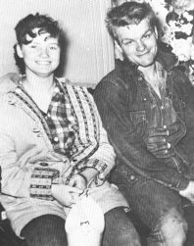
Spree Murderers
A spree killer is much like a serial killer.
  CHARACTERISTICS
    Kills more than one person at two or more locations.
    Happens quickly – with no cooling off period.
    Killer is constantly moving…hiding, running, planning.
    Often end with suicide.
1957-1958
Charles Starkweather and Caril Fugate.
Murdered 11 people in 6 weeks – Nebraska
Starkweather …got the chair 1959. Fugate.. Paroled in 1977
1997
Andrew Cunanan
Killed 5 men in 4 states (Mn, Il. NJ, Fl)
Time: 3 months
Committed suicide

Slide 12
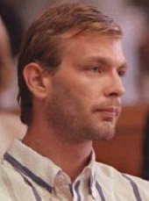
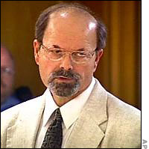
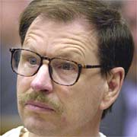
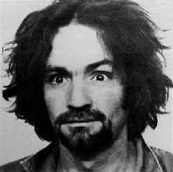
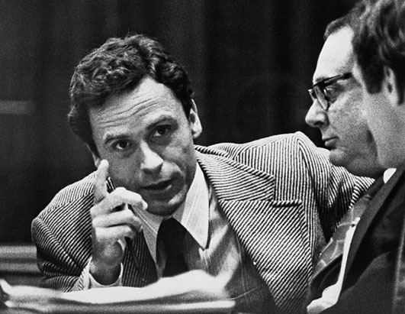
The Serial Killer
Kill three or more people over a period of more than a month
Cooling off time in between….may be as long as 3 months
Uses the time to unwind…come down off the “killing high”
Motivation for killing is usually based on psychological gratification
Rarely display a clearly define or rational motive
Notes:
Jeffrey Dahmer “Milwaukee Cannibal”, Ted Bundy “

Slide 13
WARNING
This project can be very disturbing.
If you need to take a break from the class material PLEASE let me know.

Slide 14
Criminal Profiling
Possible solution to battling serial offences
A behavioral and investigative tool that is intended to help investigators to accurately predict and profile the characteristics of unknown criminal subjects or offenders.
Notes:
Offender profiling is a method of identifying the perpetrator of a crime based on an analysis of the nature of the offense and the manner in which it was committed. Various aspects of the criminal's personality makeup are determined from his or her choices before, during, and after the crime.^{[5]} This information is combined with other relevant details and physical evidence, and then compared with the characteristics of known personality types and mental abnormalities to develop a practical working description of the offender.
Psychological profiling may be described as a method of suspect identification which seeks to identify a person's mental, emotional, and personality characteristics (as manifested in things done or left at the crime scene).^{[6]} This was used in the investigation of the serial murders committed by Ted Bundy. Dr. Richard B. Jarvis, a psychiatrist with expertise on the criminal mind, predicted the age range of Bundy, his sexual psychopathy, and his above average intellect.^{[7]}

Slide 15
Criminal Profiling
Some Assumptions of the Profiling Process
1. The Crime Scene reflects the personality.
  Manner of death
  Organized or disorganized crime scene
2. Methods of operation remain similar.
  Clues left could be a “signature” of the killer.
3. The “signature” will remain the same.
  Unique manner in which a crime is committed.
  Manner, words used, something left at the scene.
4. The criminal’s personality will not change.
  Core personality cannot change.
Notes:
Offender profiling is a method of identifying the perpetrator of a crime based on an analysis of the nature of the offense and the manner in which it was committed. Various aspects of the criminal's personality makeup are determined from his or her choices before, during, and after the crime.^{[5]} This information is combined with other relevant details and physical evidence, and then compared with the characteristics of known personality types and mental abnormalities to develop a practical working description of the offender.
Psychological profiling may be described as a method of suspect identification which seeks to identify a person's mental, emotional, and personality characteristics (as manifested in things done or left at the crime scene).^{[6]} This was used in the investigation of the serial murders committed by Ted Bundy. Dr. Richard B. Jarvis, a psychiatrist with expertise on the criminal mind, predicted the age range of Bundy, his sexual psychopathy, and his above average intellect.^{[7]}

Slide 16
F.B.I. Crime Scene Analysis
Distinguishes two types of crime scenes as the basis of psychological profiling:
Organized Offender
High intelligence
Socially adequate
Sexually competent
Lives with a partner
High birth order status
Father had/has stable work
Childhood discipline inconsistent
Situational stress causes crime
Charming
Is mobile
Follows crime in media
TED BUNDY
Disorganized Offender
Below average intelligence
Socially inadequate
Sexually incompetent
Works at unskilled labor
Low birth order status
Father had/has unstable work
Received harsh discipline as child
Mood is anxious during crime
Stress not a factor in causing crime
Lives alone/does not date
Poor personal hygiene
Not interested in media
Nocturnal
Significant behavior changes after crime
RICHARD RAMIREZ

Slide 17
A Comparison of Crime Scenes
Organized
Planned
Victim targeted
Personalizes victim
Controlled conversations
Controlled crime scene
Submissive victim
Restraints used
Aggressive acts
Body is moved
Weapon taken
Little evidence
Disorganized
Spontaneous event
Victim unknown
Depersonalizes victim
Minimal conversation
Chaotic crime scene
Sudden violence
No restraints
Sex after death
Body not moved
Weapon left
Physical evidence

Slide 18
Characterizing a Killer
Stable
Lives and works in one location.
Hunts and kills in a single region.
Pattern of body disposal in same area.
Concealment of bodies important.
Often returns to crime site.
Seldom travels
Transient
Moves consistently. Doesn’t stay in one spot for more than a few weeks.
Kills need to be mapped. Happen over large areas.
Random body disposal.
Convenience for disposal is valued over concealment.
Seldom returns to the scene.
Travels constantly.

Slide 19
Serial Murderer - Types
Visionary – “sees things”; psychopathic, directed by “another being”
Missionary – need to eradicate a certain group, not psychotic.
Hedonistic – seeks thrill and derives pleasure from killing.
Power/Control – sexual gratification from dominance of victim…power of life and death.

Slide 20
Common Characteristics of Serial Killers
White male
Age 25-35
Intelligence – ranges from low to very high
From all walks of life
  May be the married man next door with kids
    OR
  Socially inept/unable to maintain relationship/ loner
Kill for sex, power, manipulation, domination and control

Slide 21
Common Characteristics of Victims
Usually kill within ethnic group
Age of victims varies greatly (depending on murder)
Usually no prior contact/hatred for victim
Victims may be symbolic in some way

Slide 22
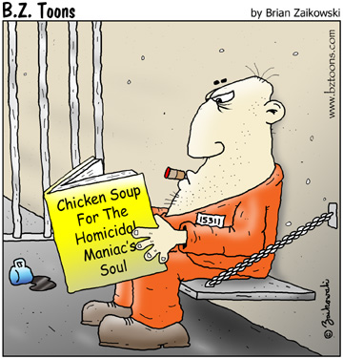
Socially Difficult to Accept
Psychopaths/sociopaths
  Self-centered (egocentric and narcissistic)
  Manipulative
  Emotionally shallow
  Devoid of empathy/remorse

Slide 23

Fantasy
All humans fantasize about their dreams and futures – usually very detailed
Serial killers have detailed fantasies
  Specific victims
  Repetitive
  Reveals modus operandi (MO – method of operation)/ signature
Helps Forensic psychiatrists develop profiles of the killers

Slide 24


Trophies or Souvenirs
Criminals
  Money, jewels, electronics
  Incriminating evidence (weapon)
Serial killers
  Take objects with no monetary value
  Holds value to perpetrator
  Use it to relive crime later
    Ex: jewelry, clothing, drivers license, even body parts

Slide 25
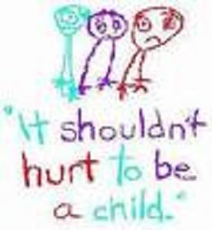

Childhood
Many come from physical, psychological, and sexual abuse
Insulate self by creating protective world rich in fantasy
Fantasy includes sexual and violent characteristics
  Themes commingle until they are inseparable
  Offenders seek victims that fulfill their fantasy
    Ex: Ted Bundy – women with dark hair parted in middle

Slide 26
Serial Killer Project
You’ll build a profile of a serial killer you select through research.
Deliverables:
Research paper
Presentation of your learning

