Slide 1
Cell Signaling
Signal Transduction Pathways
Erlenbeck - 2018

Slide 2
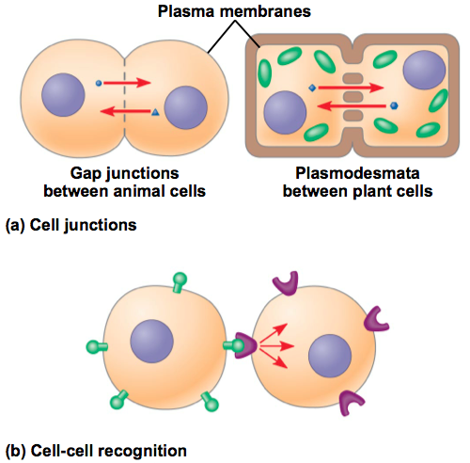
Cells Communicate!
Direct Contact (Gap Junctions & Plasmodesmatas)
Receptors on the cell surface
Local Signaling (Paracrine & Synaptic)
Long distance Signaling (Hormone Signaling)

Slide 3
Epinephrine
An epinephrine study helped scientists understand how cells communicate.
Epinephrine is secreted during physical or mental stress. It’s main job is to mobilize fuel reserves.
Scientists knew that epinephrine activates glycogen phosphorylase causing fuel reserve mobilization. But when scientists put those two substances in a test tube with its substrate (glycogen) nothing happened. Why?
Means that epinephrine does not interact directly with the enzyme and intermediate step must be occurring inside the cells.

Slide 4
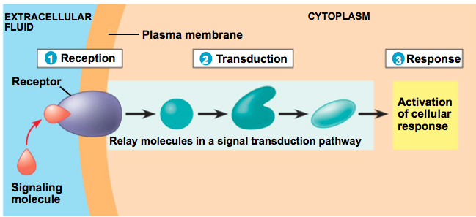
Cells Communicate!
The cell receives a signal and that signal is a message to the cell to do something. The signal goes through 3 main stages.
Reception. Transduction. Response.

Slide 5
Reception
A signaling molecule binds to a receptor protein causing it to change shape.
A signaling molecule (also called a ligand) is complementary in shape to a specific site on the receptor.
Receptors can be on/in the cellular membrane (G-Protein, Tyrosine Kinases, Ion Channels) or inside the cell (hormone signaling).

Slide 6
G Protein-Coupled Receptors
A signaling molecule attaches to the receptor. This causes the receptor to change shape and attracts the G protein to attach and activate (GTP). That G protein then binds to an enzyme which triggers the next steps to a cellular response. The G protein is then deactivated (GDP) meaning the pathway can be shut down.
Notes:
Notes: Very popular! Most drugs affect G Protein Receptors & Pathways.

Slide 7
Receptor Tyrosine Kinases
A signaling molecule attaches to the receptor. This causes the receptor to change shape by moving together and creating a dimer. The receptor is then activated (added phosphates to tyr). Relay proteins are then attracted to the receptor, bind, change shape, and triggers the next steps to a cellular response.
Notes:
Benefits: Multiple signal transduction pathways can be triggered at once.

Slide 8
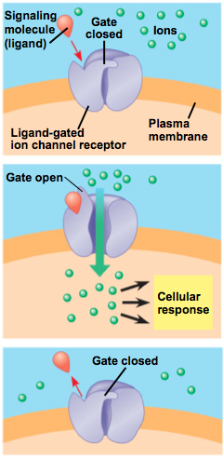
Ion Channel Receptors
A signaling molecule attaches to the receptor. This causes the receptor to change shape – meaning the gate that is normally closed will open allowing ions to move in or out of the cell. When the ligand leaves the receptor changes shape to it’s original state (closed).
Notes:
Notes: Very important in nervous system – specifically in synaptic communication between two nerve cells.

Slide 9
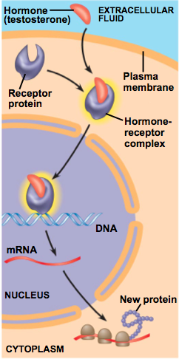
Intracellular Receptors – Hormone Signaling
A signaling molecule (hormone) travels through the plasma membrane and attaches to a receptor protein in the cytoplasm. The hormone-receptor complex then moves into the nucleus and bind to specific genes. The complex acts as a transcription factor, causing the gene it binds with to be transcribed into mRNA then translated into a protein. This protein is the cellular response.

Slide 10
The cell receives a signal and that signal is a message to the cell to do something. The signal goes through 3 main stages.
Reception. Transduction. Response.

Slide 11
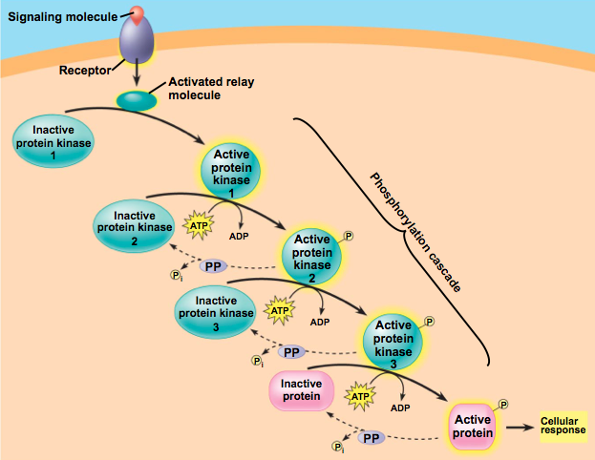
Transduction.. Whoa.
Why so complex?
Multistep pathways enable the cell to amplify the signal and increase overall complexity of the reaction (increase coordination and regulation)
What is really going on in that mess?
ACTIVATE: Adding phosphates “phosphorylation”
DEACTIVATE: Removing phosphates “dephosphorylation”

Slide 12
In detail: Ligand binds to receptor which activates a relay molecule. This attracts an inactive protein kinase. To make it active, ATP must give a phosphate to the protein which activates it (changes shape). This bumps into another protein kinase.. Add a phosphate to activate it.. Sends message along until it hits and activates a protein that causes the cell response.

Slide 13
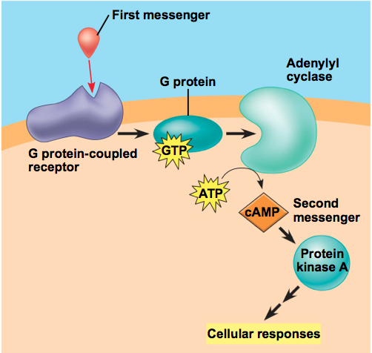
Cyclic AMP - cAMP
Secondary Messengers
The first messenger is always the signaling molecule that attaches to the receptor.
In the figure to the right, a secondary messenger (cAMP) is needed to complete the transduction pathway which leads to the cellular response.

Slide 14
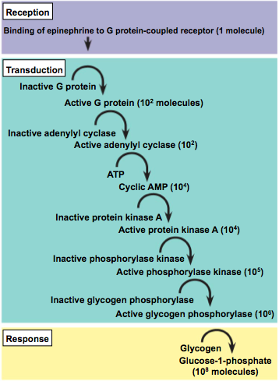
Remember epinephrine?
It was missing an intermediate step.
Why have this intermediate step?
Amplifies the signal!
1 molecule creates 100,000,000 glycogen molecules? INSANE!

Slide 15
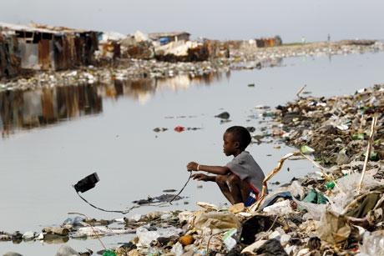
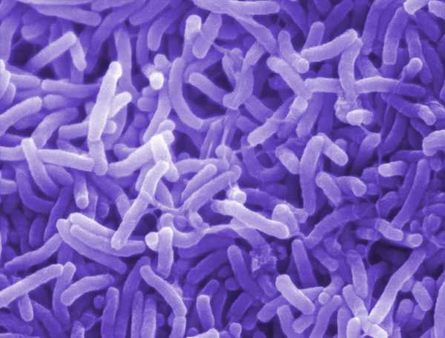
Another Example: Cholera
Common in places where water is contaminated with human feces. The bacteria attach to the small intestines and produce a toxin that chemically modifies a G protein receptor. It is unable to deactivate itself. (Can’t go from GTP to GDP). This means it is always on and continuously making the secondary messenger cAMP. Well increases in cAMP in intestinal cells causes them to secrete large amounts of salts into the intestinal space.
Why do the patients die?
Notes:
Die due to water moving from their cells to the space in an attempt to reach osmatic equilibrium, they dehydrate and die.

Slide 16
Summary
Reception: Getting the signal. Changing Shape. Attract relay molecule. (3 big ones: G-Protein, Tyrosine Kinase, Ion Channels)
Transduction: Relay molecules activate (phosphorylation) and deactivate (dephosphorylation) which send the message throughout the cell.
Response: Cell responds to the signal. Could create proteins, could grow, could divide, could die, could do anything!
Apoptosis

Slide 17
Application Questions
What would the effect be if a cell made defective receptor tyrosine kinase proteins that were unable to dimerize?
What would be the effect of overactive secretion of testosterone from the testis? (In regards to cellular communication.)

